Slide 1

LOAN APPLICATIONS
10 BIZMARROW PROJECT
PRESENTED BY MISS JANEFRANCES

Slide 2
INTRODUCTION
One critical aspect of banking is loan applications, where banks assess applicant's creditworthiness to determine the likelihood of repayment. Through loan application data analysis, lenders can uncover key trends and patterns and patterns in applicant profile, financial stability, and creditworthiness, driving more effective risk assessment and lending practices.
This project focuses on analyzing loan applications data using SQL to answer key business questions and provide actionable insights. The data set contains information about applicant’s demographics, income, loan amounts, purposes, credit scores etc.

Slide 3

1. WRITE A QUERY TO SELECT ALL RECORDS FROM THE LOAN APPLICATIONS TABLE.

Slide 4

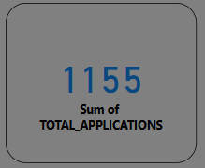
2. WHAT IS THE TOTAL NUMBER OF LOAN APPLICATIONS.

Slide 5

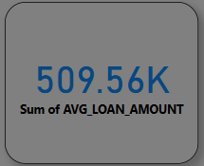
3. WHAT IS THE AVERAGE LOAN AMOUNT ?

Slide 6
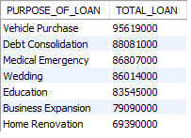
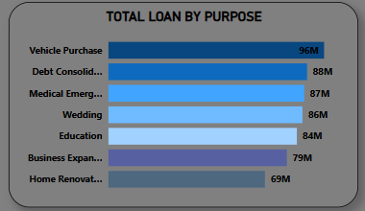
4. WHAT IS THE TOTAL LOAN AMOUNT FOR EACH PURPOSE? ORDER THE RESULTS BY TOTAL LOAN AMOUNT IN DESCENDING ORDER.

Slide 7
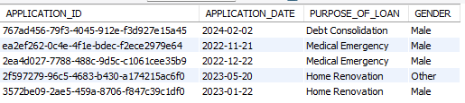
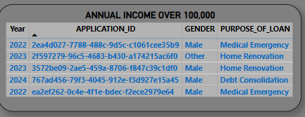
5. RETRIEVE ALL APPLICATIONS WHERE ANNUAL INCOME IS GREATER THAN 100,000.

Slide 8
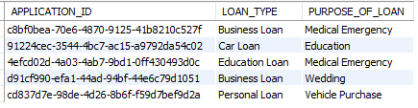
6. SHOW ALL APPLICATIONS APPROVED WITH LOAN AMOUNT OVER 50,000.

Slide 9
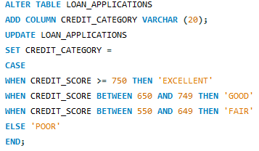
7. ADD A NEW COLUMN CALLED CREDIT CATEGORY WITH THE FOLLOWING LOGIC : ‘EXCELLENT’ IF CREDIT SCORE ≥ 750, ‘GOOD’ IF 650–749-, ‘FAIR’ IF 550–649, ‘POOR’ IF BELOW 550.

Slide 10
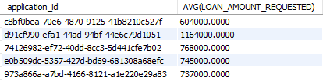
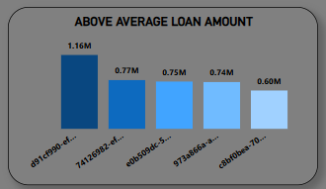
8. RETRIEVE ALL APPLICATIONS WITH LOAN AMOUNT HIGHER THAN THE OVERALL AVERAGE LOAN AMOUNT.

Slide 11

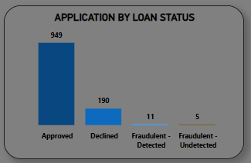
9. SHOW APPROVAL STATUS AND COUNT OF APPLICATIONS FOR EACH STATUS.

Slide 12
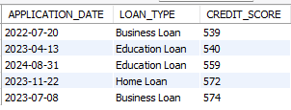
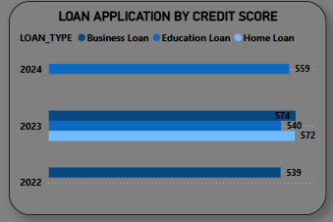
10. LIST ALL APPLICATIONS ORDERED BY CREDIT SCORE IN ASCENDING ORDER.

